Slide 1
Node.js
Mendel Rosenblum

Slide 2
Threads
versus
Events
request = readRequest(socket); reply = processRequest(request); sendReply(socket, reply);
readRequest(socket, function(request) { processRequest(request,
function (reply) { sendReply(socket, reply);
});
});
Implementation:
Event queue processing
Implementation:
Thread switching (i.e. blocking) and a scheduler

Slide 3
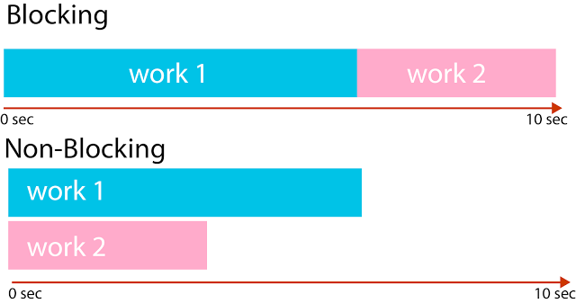
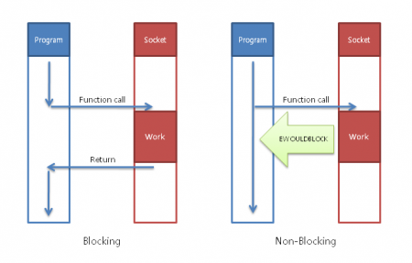
Blocking vs Non-blocking

Slide 4
Event queue
Inner loop
while (true) {
if (!eventQueue.notEmpty()) { eventQueue.pop().call();
}
}
Never wait/block in event handler . Example readRequest(socket);
  launchReadRequest(socket); // Returns immediately
  When read finishes: eventQueue.push(readDoneEventHandler);

Slide 5
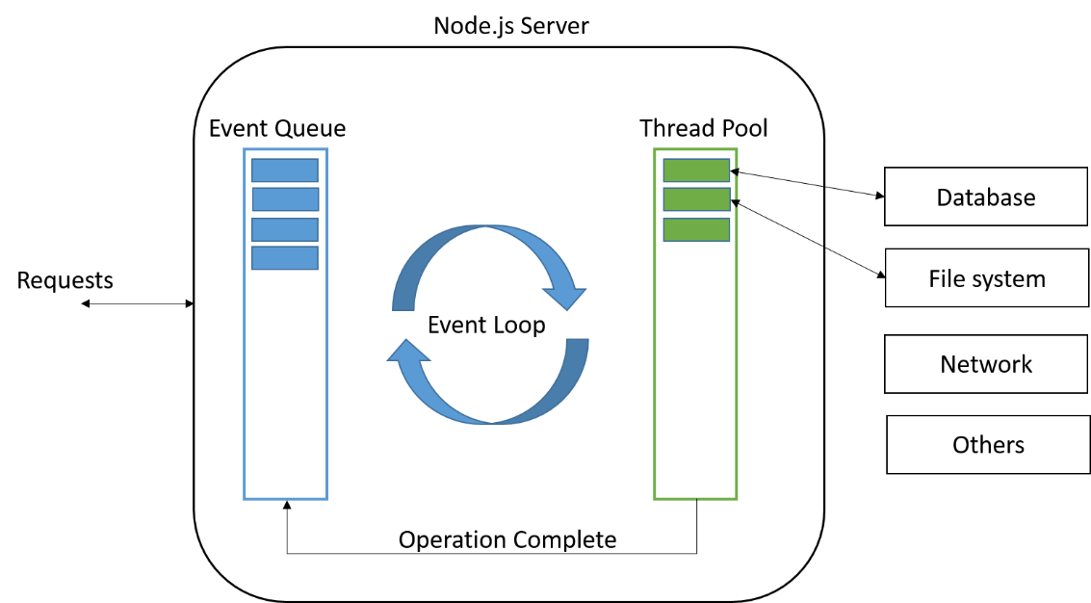
Event queue

Slide 6
Node.js
Take a JavaScript engine from a browser (Chrome's V8 JavaScript Engine)
  Get same JavaScript on both browser and server
  Don't need the DOM on the server
Add events and an event queue
  Everything runs as a call from the event loop (already had one for browser events)
Make event interface to all OS operations
  Wrap all the OS blocking calls (file and socket/network io)
  Add some data handle support
Add a proper module system
  Each module gets its own scope (not everything in window)

Slide 7
Example: Node.js reading a file
var fs = require("fs"); // require is a Node module call
// fs object wraps OS sync file system calls
// OS read() is synchronous but Node's fs.readFile is asynchronous
fs.readFile("smallFile", readDoneCallback); // Start read
function readDoneCallback(error, dataBuffer) {
// Node callback convention: First argument is JavaScript Error object
// dataBuffer is a special Node Buffer object
if (!error) {
console.log("smallFile contents", dataBuffer.toString());
}
}

Slide 8
Node Modules
Import using require() - Can use ES6 import if file name *.mjs
  System module: require("fs"); // Looks in node_modules directories
  From a file: require("./XXX.js"); // Reads specified file
  From a directory: require("./myModule"); // Reads myModule/index.js
Module files have a private scope
  Can declare variables that would be global in the browser
  Require returns what is assigned to module.exports
var notGlobal; function func1() {} function func2() {}
module.exports = {func1: func1, func2: func2};

Slide 9
Node modules
Many standard Node modules
  File system, process access, networking, timers, devices, crypto, etc.
Huge library of modules (npm)
  Do pretty much anything you want
We use:
  Express - Fast, unopinionated, minimalist web framework (speak HTTP)
  Mongoose - Elegant mongodb object modeling (speak to the database)

Slide 10
Node Buffer class
Manipulating lots of binary data wasn't a strength of the JavaScript engine
  Unfortunately that is what web servers do: DBMS ⇔ Web Server ⇔ Browser
Node add a Buffer class - Optimized for storing and operating on binary data
  Interface looks an array of bytes (like the OS system calls use)
  Memory is allocated outside of the V8 heap
Used by the wrapped OS I/O calls (fs, net, …)
Optimized sharing with pointers rather than always copying
  buffer.copy()
  For example: fs.readFile to socket.write

Slide 11
Buffer operations
Supports operations for picking values out or updating them
  Can peek at some values and send the bulk of it on its way
Can convert a buffer or parts of a buffer to a JavaScript string
  buf.toString("utf8"); // Convert to UTF8 - commonly used on the web
  buf.toString("hex"); // Convert to hex encoding (2 digits per byte)
  buf.toString("base64"); // Convert to base64 encoding

Slide 12
Example: Node.js reading a file (redux)
var fs = require("fs");
// fs has 81 properties readFile, writeFile, most OS calls, etc.
fs.readFile("smallFile", readDoneCallback); // Start read
// Read has been launched - JavaScript execution continues
// Node.js exits when no callbacks are outstanding
function readDoneCallback(error, dataBuffer) {
// console.log(dataBuffer) prints <Buffer 66 73 20 3d 20 72 65 71 ...
if (!error) {
console.log("smallFile contents", dataBuffer.toString());
}
}
CS142 Lecture Notes - Node.js

Slide 13
Programming with Events/Callbacks
Key difference
  Threads: Blocking/waiting is transparent
  Events: Blocking/waiting requires callback
Mental model
If code doesn't block: Same as thread programming
If code does block (or needs to block): Need to setup callback
Often what was a return statement becomes a function call

Slide 14
Example: Three step process
Threads
r1 = step1(); console.log('step1 done', r1); r2 = step2(r1); console.log('step2 done', r2); r3 = step3(r2); console.log('step3 done', r3); console.log('All Done!');
Callbacks
step1(function(r1) { console.log('step1 done', r1); step2(r1, function (r2) {
console.log('step2 done', r2); step3(r2, function (r3) {
console.log('step3 done',r3);
});
});
}):
console.log('All Done!'); // Wrong!
Works for non-blocking
calls in both styles

Slide 15
Example: Three step process
Threads
r1 = step1(); console.log('step1 done', r1); r2 = step2(r1); console.log('step2 done', r2); r3 = step3(r2); console.log('step3 done', r3); console.log('All Done!');
Callbacks
step1(function(r1) { console.log('step1 done', r1); step2(r1, function (r2) {
console.log('step2 done', r2); step3(r2, function (r3) {
console.log('step3 done', r3);
console.log('All Done!');
});
});
});

Slide 16
Listener/emitter pattern
When programing with events (rather than threads) a listener/emitter pattern is often used.
Listener - Function to be called when the event is signaled
Should be familiar from DOM programming (addEventListerner)
Emitter - Signal that an event has occurred
Emit an event cause all the listener functions to be called

Slide 17
Node: EventEmitter = require('events');
Listen with on() and signal with emit()
myEmitter.on('myEvent', function(param1, param2) {
console.log('myEvent occurred with ' + param1 + ' and ' + param2 + '!');
});
myEmitter.emit('myEvent', 'arg1', 'arg2');
On emit call listeners are called synchronously and in the order the listeners were registered
If no listener then emit() is a nop

Slide 18
Typical EventEmitter patterns
Have multiple different events for different state or actions myEmitter.on('conditionA', doConditionA); myEmitter.on('conditionB', doConditionB); myEmitter.on('conditionC', doConditionC); myEmitter.on('error', handleErrorCondition);
Handling 'error' is important - Node exits if not caught!
myEmitter.emit('error', new Error('Ouch!'));

Slide 19
Streams
Build modules that produce and/or consume streams of data
A popular way of structuring servers
  Network interface ⇔ TCP/IP protocol processing ⇔ HTTP protocol processing ⇔ your code
Can build connected streams dynamically
  Add modules on stream: E.g. stream.push(Encryption)
Network interface ⇔ TCP/IP protocol processing ⇔ Encryption ⇔ HTTP processing
Node's APIs heavily uses streams
  Readable streams (e.g. fs.createReadStream)
  Writable stream (e.g. fs.createWriteStream)
  Duplex stream (e.g. net.createConnection)
  Transform stream (e.g. zlib, crypto)

Slide 20
Readable streams - File reading using streams
var readableStreamEvent = fs.createReadStream("bigFile");
readableStreamEvent.on('data', function (chunkBuffer) { // Could be called multiple times
console.log('got chunk of', chunkBuffer.length, 'bytes');
});
readableStreamEvent.on('end', function() {
// Called after all chunks read console.log('got all the data');
});
readableStreamEvent.on('error', function (err) { console.error('got error', err);
});

Slide 21
Writable streams - File writing using streams
var writableStreamEvent = fs.createWriteStream('outputFile');
writableStreamEvent.on('finish', function () { console.log('file has been written!');
});
writableStreamEvent.write('Hello world!\n'); writableStreamEvent.end();

Slide 22
Digression: Socket setup for TCP connections
Client (Browser) Server (Web Server)
sock = socket(AF_INET, SOCK_STREAM, 0); lfd = socket(AF_INET, SOCK_STREAM, 0);
connect(sock, &serverAddr,
sizeof(serverAddr));
bind(lfd, &serverSddr, sizeof(serveraddr));
listen(lfd, 5);
write(sock, "Hi!", 3);
sock = accept(lfd, &clientaddr, &clientlen);
read(sock, buf, 3);
read(sock, buf, 3)
write(sock, buf, 3)
TCP/IP socket connection is a reliable, in-order byte stream
  Note: reads can return data in different chunks that sent

Slide 23
TCP Networking on Node.js
Node net module wraps OS's network routines
Includes higher level functionality like:
var net = require('net'); net.createServer(processTCPconnection).listen(4000);
Creates a socket, binds port 4000, and listens for connections Calls function processTCPconnection on each TCP connection

Slide 24
Example: A chat server
var clients = []; // List of connected clients function processTCPconnection(socket) {
clients.push(socket); // Add this client to our connected list
socket.on('data', function (data) { broadcast( "> " + data, socket);
});
socket.on('end', function () {
// Send received data to all
clients.splice(clients.indexOf(socket), 1); // remove socket
});
}

Slide 25
Chat Server: broadcast
// Send message to all clients
function broadcast(message, sender) { clients.forEach(function (client) {
if (client === sender) return; // Don't send it to sender
client.write(message);
});
}
Our chat server implementation is done!

Slide 26
Putting it together: A real simple file server
net.createServer(function (socket) { socket.on('data', function (fileName) {
fs.readFile(fileName.toString(), function (error, fileData) { if (!error) {
socket.write(fileData); // Writing a Buffer
} else {
socket.write(error.message); // Writing a String
}
socket.end();
});
});
}).listen(4000);
Think about concurrency going on here
CS142 Lecture Notes - Node.js

Slide 27
Example: Read three files
Linux
read(open("f1"), buf1, f1Size);
read(open("f2"), buf2, f2Size);
read(open("f3"), buf3, f3Size);
Node.js
fs.readFile("f1", function (error, data1) { fs.readFile("f2", function (error, data2) {
fs.readFile("f3", function (error, data3) {
// Call Pyramid of Doom or Callback Hell
}); }); });

Slide 28
Example: Read N files
var fileContents = {}; ['f1','f2','f3'].forEach(function (fileName) {
fs.readFile(fileName, function (error, dataBuffer) { assert(!error);
fileContents[fileName] = dataBuffer;
});
});
If we want to use fileContents how do we know when all reads are finished?
Recall: Can't wait in NodeJS

Slide 29
Example: Read N files
var fileContents = {}; ['f1','f2','f3'].forEach(function (fileName) {
fs.readFile(fileName, function (error, dataBuffer) { assert(!error);
fileContents[fileName] = dataBuffer;
if (gotLastCallBack()) allDoneCallback(fileContents);
});
});
Yuck!

Slide 30
Async module: var async = require('async');
Solution: Write a function that turns waiting into a callback
var fileContents = {};
async.each(['f1','f2','f3'], readIt, function (err) {
if (!err) console.log('Done'); // fileContents filled in
if (err) console.error('Got an error:', err.message);
});
function readIt(fileName, callback) {
fs.readFile(fileName, function (error, dataBuffer) {
fileContents[fileName] = dataBuffer; callback(error);
});
}
Notes:
Async is a utility module which provides straight-forward, powerful functions for working with asynchronous JavaScript.

Slide 31
Node.JS - many useful built-in modules
Buffer
C/C++ Addons
Child Processes
Cluster
Console
Crypto
Debugger
DNS
Errors
Events
File System
Globals
HTTP
HTTPS
Modules
Net
OS
Path
Process
Punycode
Query Strings
Readline
REPL
Stream
String Decoder
Timers
TLS/SSL
TTY
UDP/Datagram
URL
Utilities
V8
VM
ZLIB

